Slide 1
Semantic Image Classification
Jared Spang

Slide 2
Presentation Contents
Motivation
Overview of the model
Detailed view of the model
Semantic augmentation
Analysis
Conclusion

Slide 3
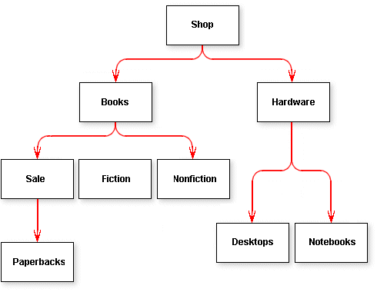
Motivation
Can we improve on image classification tasks through the use of semantics?
Image relationships, image hierarchies, etc.
ImageNet images form hierarchies [1]
Figure 1: Example of a hierarchy [2]

Slide 4
Related Work
“Imagenet classification with deep convolutional neural networks” [11]
“Improving image classification using semantic attributes” [12]
“The intelligent surfer: Probabilistic combination of link and content information in pagerank” [13]
“Semantic object recognition by merging decision tree with object ontology” [14]

Slide 5
Overview of the Model

Slide 6
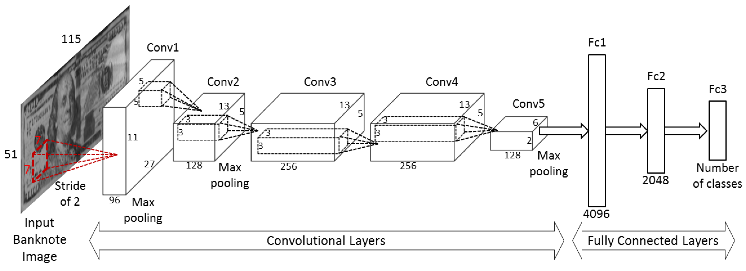
Figure 2: Example of a CNN for Banknote classification [3]
Semantic Augmentation
ImageNet Images
Convolutional Neural Network
Results

Slide 7
The Data
What is ImageNet? [1]
A very large (~14.2 million) image database used in object recognition research and competition
Data cleaning and preprocessing
Synset merging (via link for space), removing corrupt images, resizing, etc.
Hierarchy scraping to form Turtle file
ImageNet Semantic backing by WordNet nouns

Slide 8
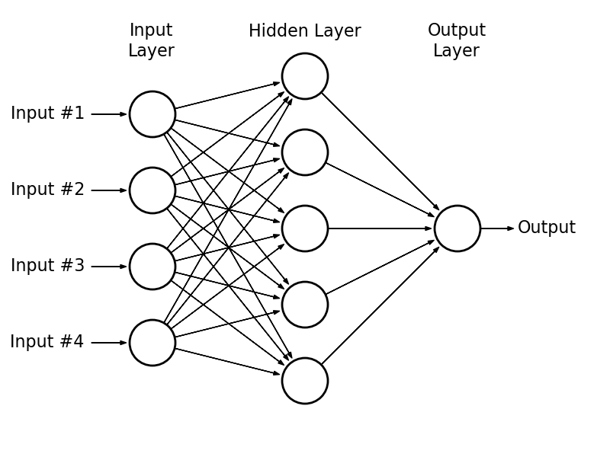
Neural Network (ANN)
What is a Neural Network?
Machine learning models often used for classification and regression
Consists of “neurons” (nodes) connected together by weighted edges
Takes an input, passes it though the neurons, outputs a result
Figure 3: Simple feedforward ANN [4]

Slide 9







Terminology
Each node contains an “Activation Function”
Modify input data before passing it on (sigmoid in this case)
Loss Function (Cost Function)
Accuracy metric for model prediction
Optimization Function
Function used to improve NN accuracy
Neuron
$$X_{1}$$
$$w_{1}$$
$$X_{2}$$
$$w_{2}$$
Sigmoid(
$$X_{1}w_{1}+X_{2}w_{2}$$
$+ X_{3}w_{3}$)
Output
$$w_{3}$$
$$X_{3}$$
Figure 4: ANN Output Neuron

Slide 10
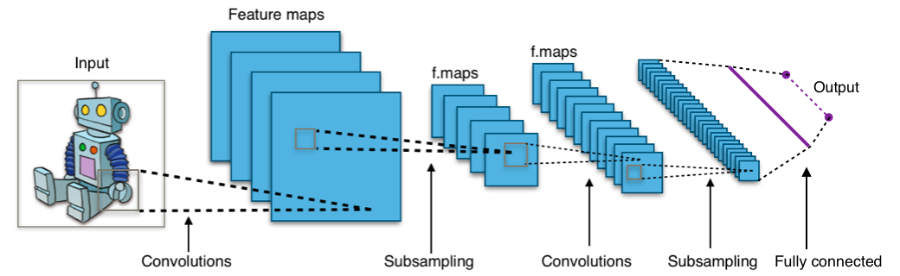
Convolutional Neural Network (CNN)
*
The convolutional layers deconstruct an image into features
Feature maps represent a “feature” from the input image
Each feature map is composed of units that each look for the feature in different portions of the input
*
Figure 5: Visual Representation of CNN [5]

Slide 11
Convolutional Neural Network (CNN) cont.
*
Take feature maps and output to traditional NN
NN determines what combination of features each class has
Outputs the result in final layer (threshold for classification)
*
Figure 5: Visual Representation of CNN [5]

Slide 12
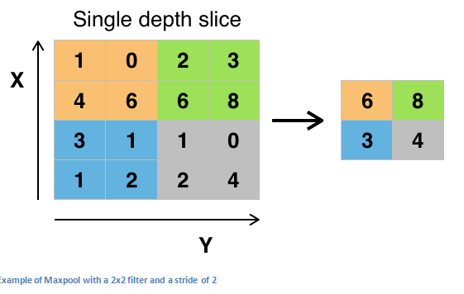
Features and Pooling
Features are typically simple shapes identified by the network
E.g. vertical line, diagonal line, etc.
Pooling (maxpooling)
Computational cost & Overfitting
Subsamples the “neuron”
Many different types of pooling
L2, average, etc.
Figure 6: Maxpooling Example [6]

Slide 13
Deeper View of the Model

Slide 14
The Model Mk. 1
Three Convolutional Layers (32, 32, 64) followed by a fully connected layer (64) and an output (9)
ReLU
ReLU
ReLU
ReLU
Softmax
32
32
64
64
9
Loss Function: Categorical Cross-Entropy
Think of the feature detectors (green) as neurons

Slide 15
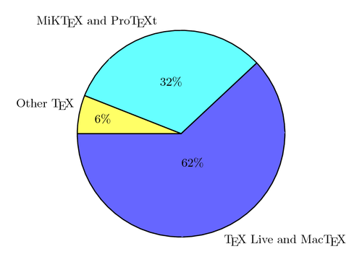
Problems with Model Mk. 1
Multiclass single-label classification not sufficient (e.g. can’t be both a tree and an oak tree)
Data needed to be re-encoded for multi-label classification
Softmax and Categorical Cross-Entropy assume a categorical distribution
Figure 7: Categorical Distribution Pie Chart [7]

Slide 16
The Model Mk. 2
Three Convolutional Layers (32, 32, 64) followed by a fully connected layer (64) and an output (9)
ReLU
ReLU
ReLU
ReLU
Sigmoid
32
32
64
64
9
Loss Function: Binary Cross-Entropy
Think of the feature detectors (green) as neurons

Slide 17
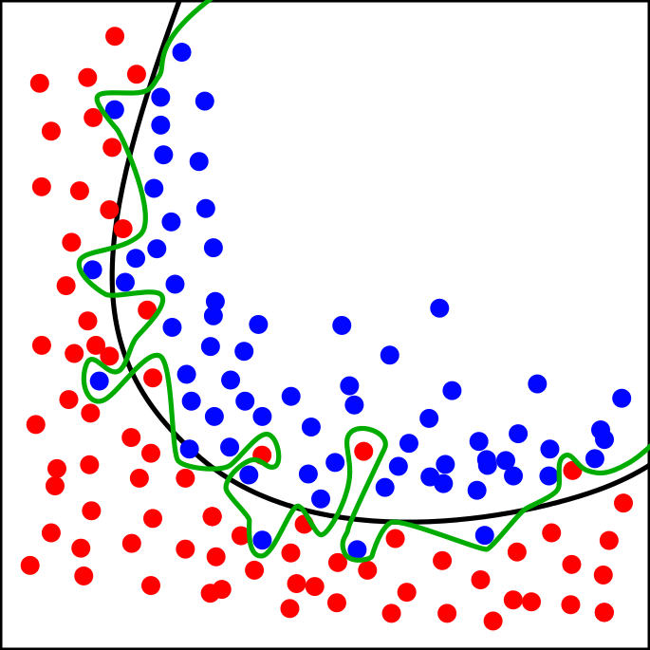
Problems with Model Mk. 2
Problems with overfitting, data augmentation was not enough
Improve performance through hyperparameter tuning
Overall, performed decently well (>80% accuracy)
Figure 8: Classification Overfitting [8]

Slide 18
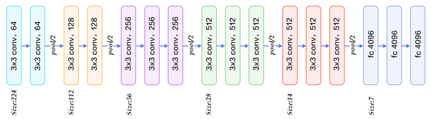
The Model Mk. 3 (final)
Utilized VGG16 framework using transfer learning for feature extraction then added two fully connected layers (256, 64) and the output (9)
ReLU
ReLU
Sigmoid
256
64
9
Loss Function: Binary Cross-Entropy

Slide 19
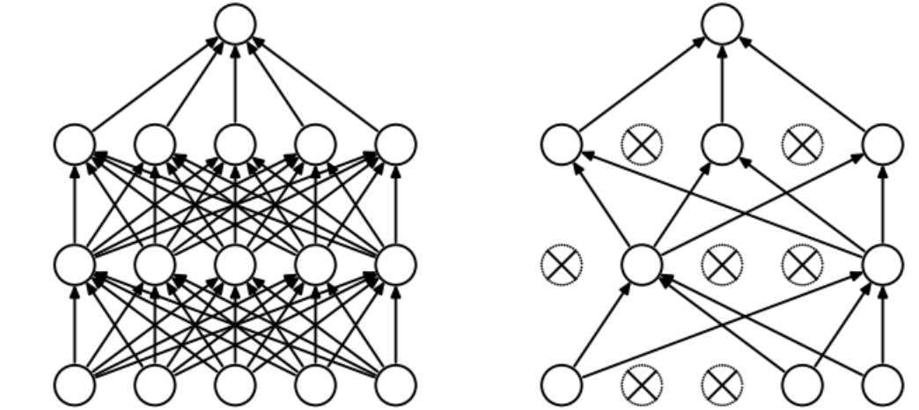
Model Mk. 3
Additional methods to prevent overfitting were also added (dropout & batch normalization)
Did well overall (~90% accuracy)
Still encountered an overfitting issue
Figure 9: NN Dropout [9]

Slide 20
Semantic Augmentation

Slide 21
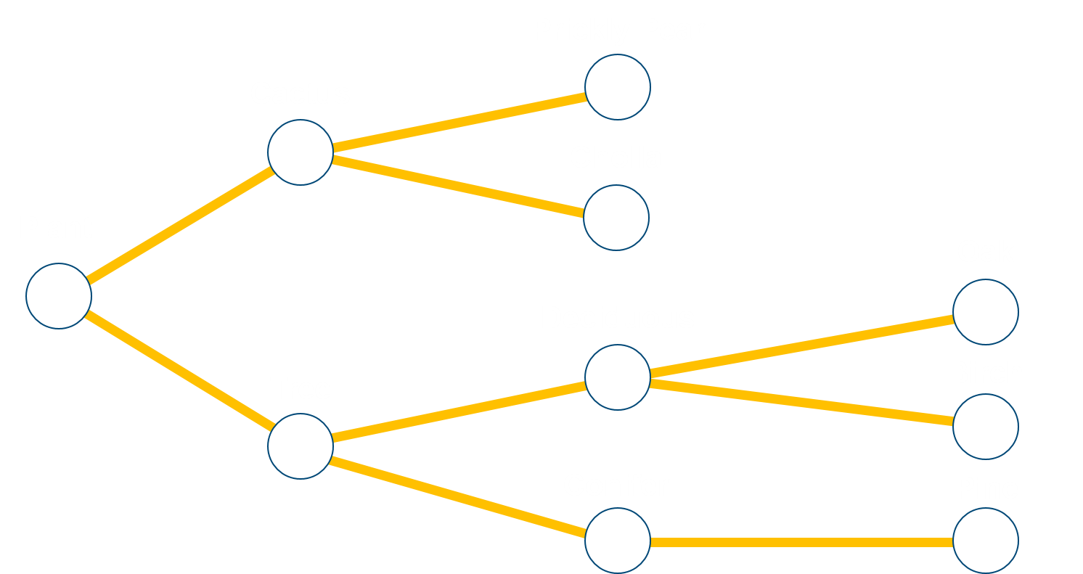
Subsection of ImageNet Ontology

Slide 22
Augmentation Methods
Naïve Augmentation
Utilized simple relationship that parents are as likely as children (pine > tree?)
Weighted PageRank
Applied weighted pageRank algorithm to knowledge graph
Based on edge weights
Conifer
Pine
0.??
0.85
0.72

Slide 23
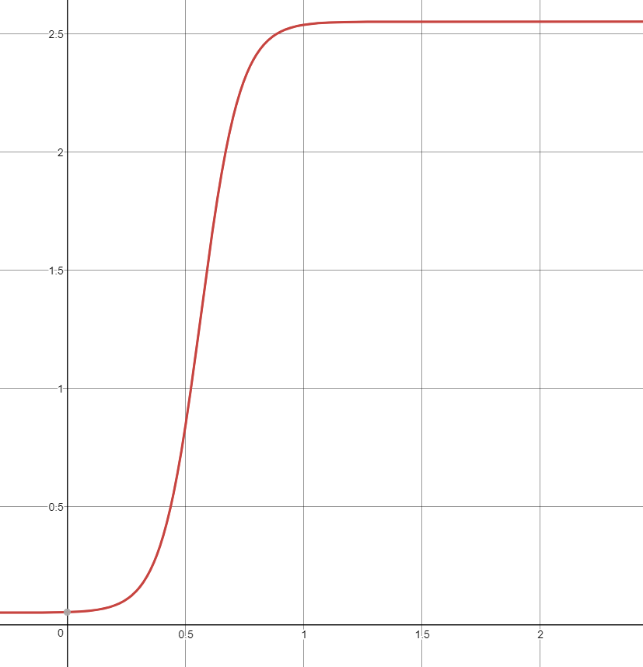

Weighted PageRank
Initially assigned weight via multiplication
Yielded poor results
Changed to logistic function
Improved results from multiplication
Hyperparameter tuning needed (damping factor, 0.6)
Figure 10: Edge Weight Mapping Function

Slide 24
Analysis

Slide 25
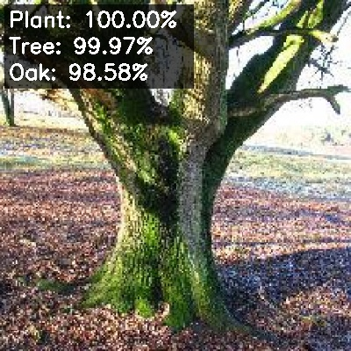
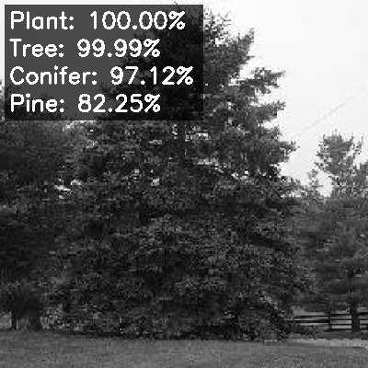
Convolutional Neural Network
Validation Accuracy: 90.5%
Test Accuracy: 96.2% (Overfitting)
Examples of Good Results:

Slide 26
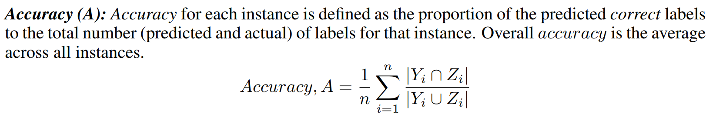
Accuracy Metrics
Both the previous results were considered 100% accurate (threshold)
Note: this is different from the loss function (Cross-Entropy in our case) which is used for optimizing NN weights
*
*
Figure 11: Multi-Label Accuracy Metric [10]

Slide 27
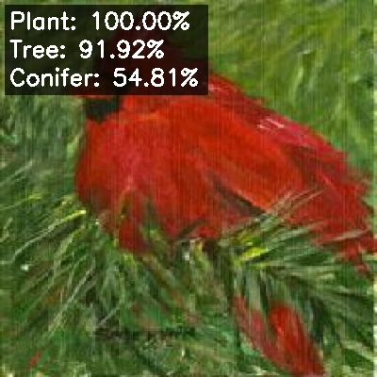
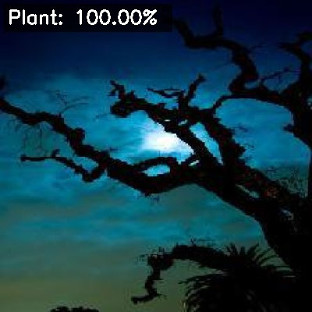
Harder Images
(Pine tree)
Close
(Oak tree)
Very Wrong

Slide 28
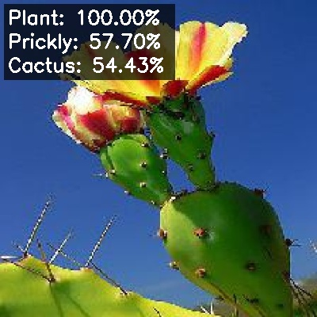
The Data Lies
Predicted to be Prickly Pear Cactus
This is indeed a Prickly Pear Cactus
However, was officially labeled Plant (from generic Plant category)
Causes loss and accuracy issues
Also, data imbalance

Slide 29
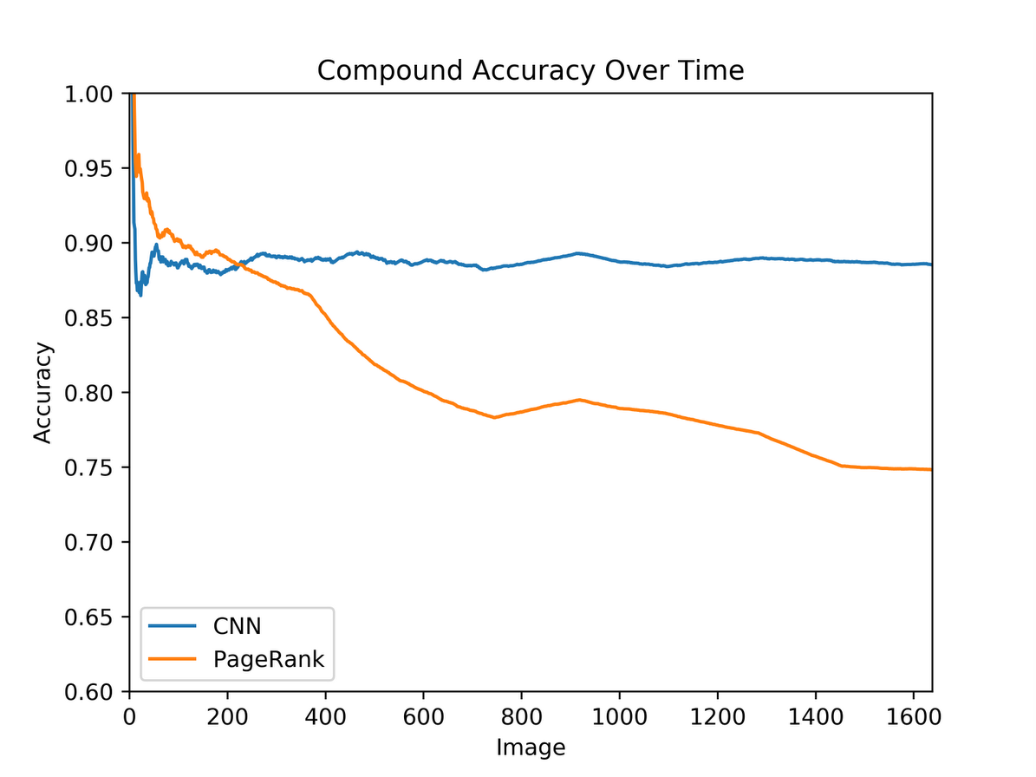
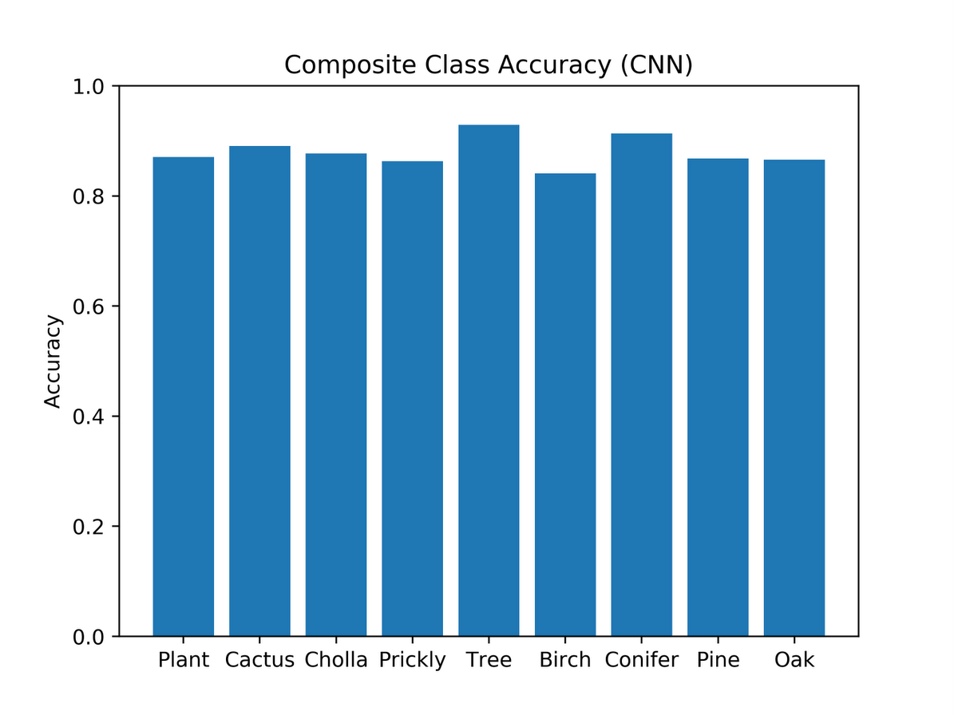
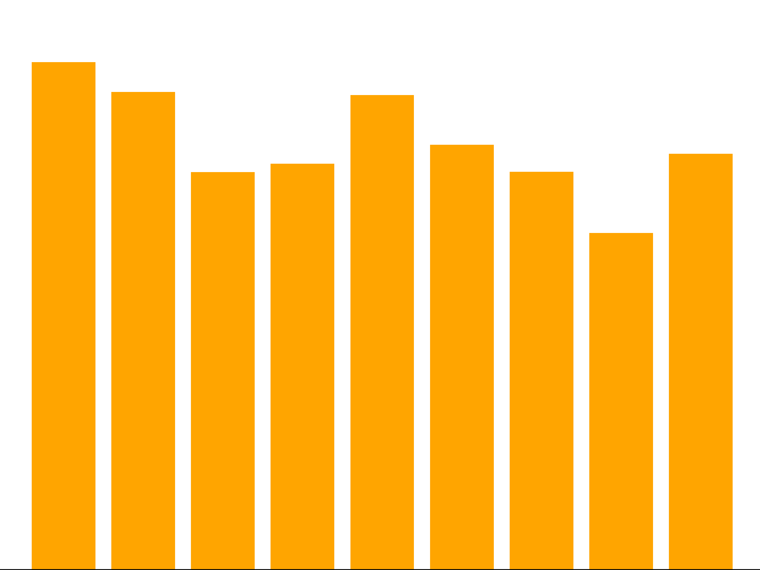
CNN vs Weighted PageRank
PageRank:
CNN:
Figure 12: Compound Accuracy
Figure 13: Semantic Composite Accuracy

Slide 30
CNN vs Naïve Semantic Augmentation
Naïve method: if a child node is labeled so must the parents
This had no effect on the results whatsoever
Figure 14: CNN Composite Accuracy

Slide 31
Future Work
Better results from more complex ontology
Tweak pageRank hyperparameters
Relies too much on graph position
Use different node ranking algorithm
Image Segmentation
Leveraging semantics to improve results

Slide 32
References
Olga Russakovsky*, Jia Deng*, Hao Su, Jonathan Krause, Sanjeev Satheesh, Sean Ma, Zhiheng Huang, Andrej Karpathy, Aditya Khosla, Michael Bernstein, Alexander C. Berg and Li Fei-Fei. (* = equal contribution) ImageNet Large Scale Visual Recognition Challenge. IJCV, 2015.
Naidamast, Steve. “Poor Man’s Hierarchy Data Tree.” Codeproject, Sept. 2017, www.codeproject.com/Articles/1205166/WebControls/WebControls/.
Pham, Tuyen Danh, et al. “Multi-National Banknote Classification Based on Visible-Light Line Sensor and Convolutional Neural Network.” Sensors, vol. 17, no. 7, 2017, p. 1595., doi:10.3390/s17071595
“Neural Network”. (n.d.). In Wikimedia Commons. Retrieved August 7, 2018, from commons.wikimedia.org/wiki/File:Neural_Network.gif
“Typical CNN”. (n.d.). In Wikimedia Commons. Retrieved August 7, 2018, from commons.wikimedia.org/wiki/File:Typical_cnn.png
“Max Pooling”. (n.d.). In Wikimedia Commons. Retrieved August 7, 2018, from commons.wikimedia.org/wiki/File:Max_pooling.png
Kottwitz, Stefan. “Latex Cookbook.” Latex Cookbook, 2015, latex-cookbook.net/cookbook/examples/pie-chart/.
Overfitting. (n.d.). In Wikimedia Commons. Retrieved August 8, 2018, from commons.wikimedia.org/wiki/File:Overfitting.svg
Srivastava, Nitish, et al. "Dropout: a simple way to prevent neural networks from overfitting." The Journal of Machine Learning Research 15.1 (2014): 1929-1958.

Slide 33
References
Sorower, Mohammad S. "A literature survey on algorithms for multi-label learning." Oregon State University, Corvallis 18 (2010).
Krizhevsky, Alex, Ilya Sutskever, and Geoffrey E. Hinton. "Imagenet classification with deep convolutional neural networks." Advances in neural information processing systems. 2012.
Su, Yu, and Frédéric Jurie. "Improving image classification using semantic attributes." International journal of computer vision 100.1 (2012): 59-77.
Richardson, Matthew, and Pedro Domingos. "The intelligent surfer: Probabilistic combination of link and content information in pagerank." Advances in neural information processing systems. 2002.
Damak, Wafa, Issam Rebai, and Imene Khanfir Kallel. "Semantic object recognition by merging decision tree with object ontology." Advanced Technologies for Signal and Image Processing (ATSIP), 2014 1st International Conference on. IEEE, 2014.

Slide 34
Questions?

